Slide 1
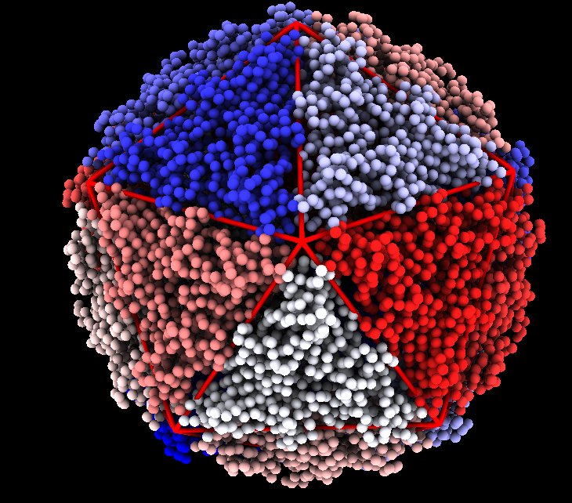
Quasi Rigid Domain Decomposition Of Icosahedral Capsids

Slide 2
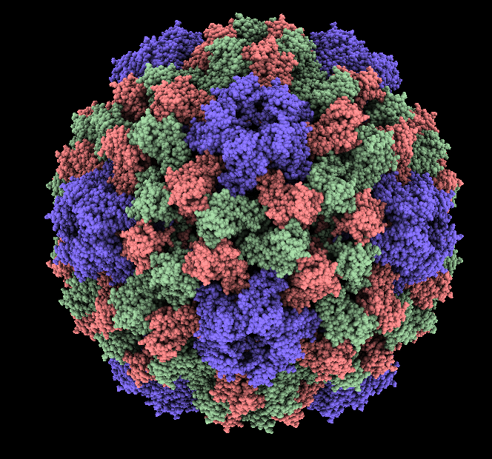
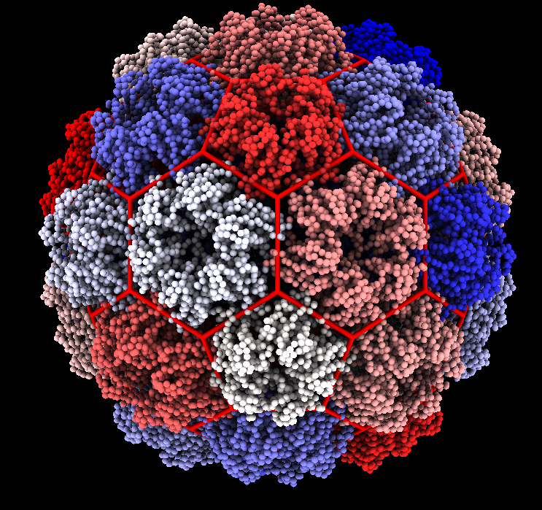
Goal
Atomic Model
Quasi-Rigid Domains

Slide 3
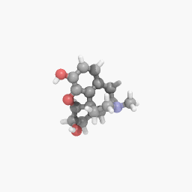
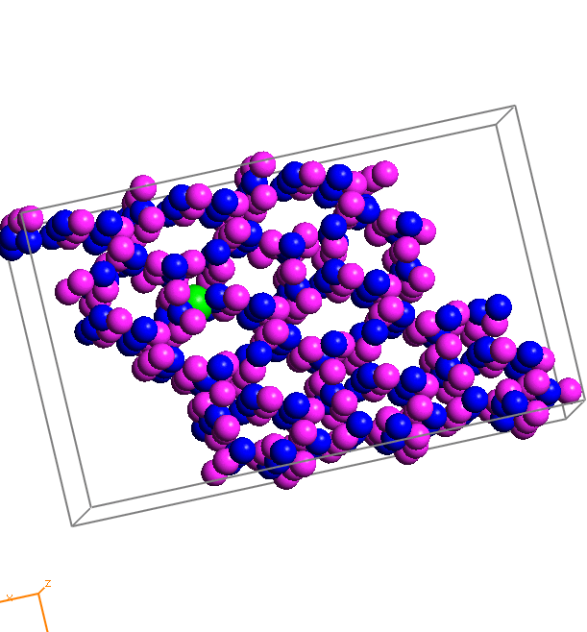
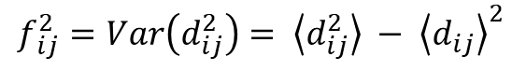
Quasi Rigidity
Fixed Internal Distances
Minimal Fluctuation Of Internal Distances
$$f_{ ij}^{2}=Var\left(d_{ij}^{2}\right)= \left\langle d_{ij}^{2}\right\rangle − {\left\langle d_{ij}\right\rangle }^{2}$$

Slide 4
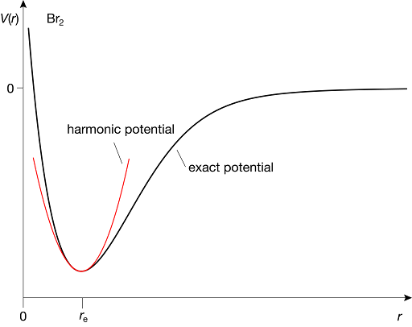
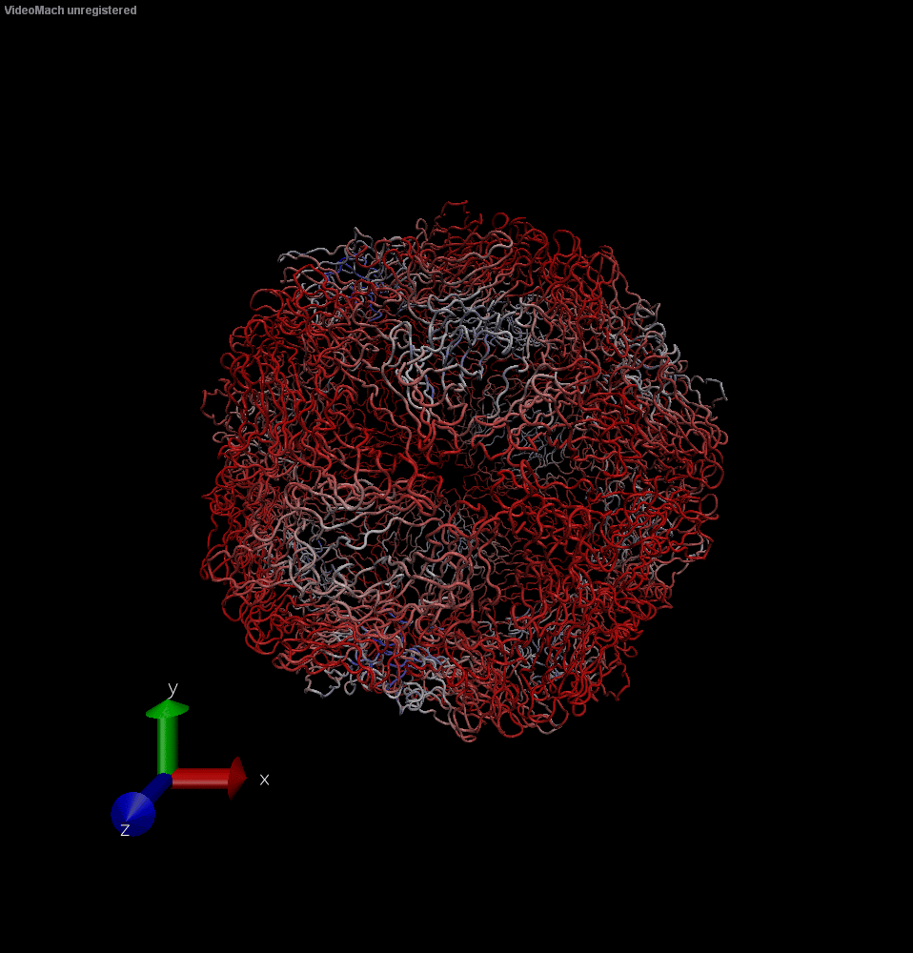
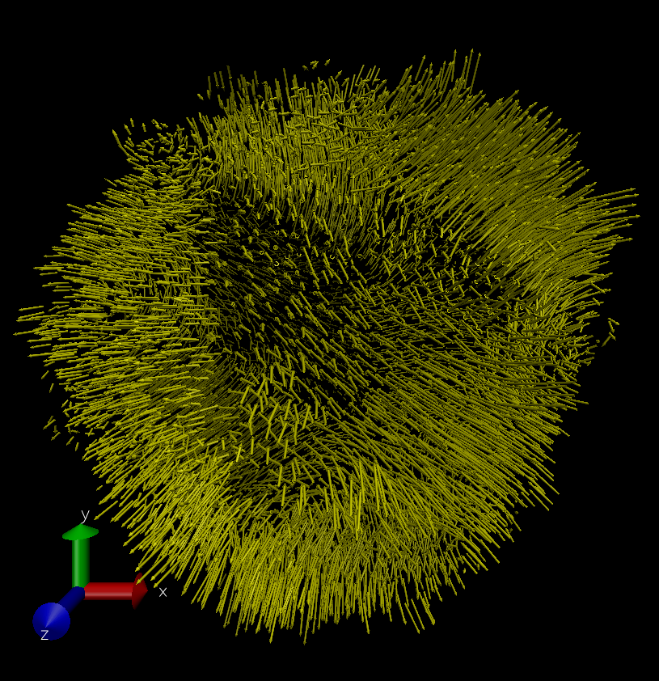
Normal Mode Analysis Features
Harmonic Potentials
Equilibrium Dynamics
Oscillatory Behavior
Normal Modes

Slide 5
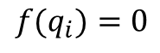
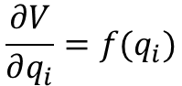

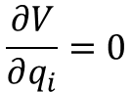
Setting up NMA
Potential
Build Hessian
Option 1:
Option 2:
$$\frac{∂V}{∂q_{i}}=f(q_{i})$$
Potential Such That
$$H_{ij}=\frac{∂^{2} V}{∂x_{i}∂x_{j}} {\left.​\right|}_{q_{eq}}$$
Solve:
$$\frac{∂V}{∂q_{i}}=0$$
$$f(q_{i})=0$$
Minimization Of V
Elastic Network Models

Slide 6
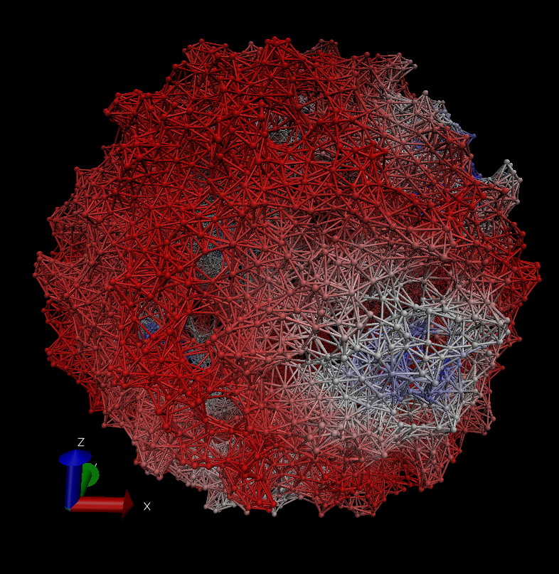
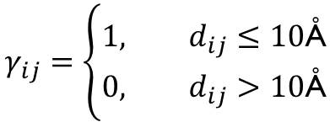
Anisotropic Network Model
Residue Coarse Graining (C_{α} Atoms)
Uniform Mass-Spring Network
$$γ_{ij}=\left\{\begin{aligned}1, d_{ij}≤10\text{Å} \\ &0, d_{ij}>10\text{Å}\end{aligned}\right.$$

Slide 7
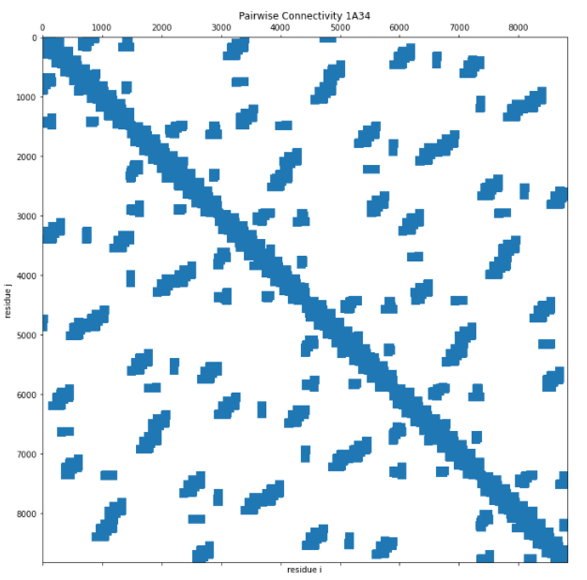
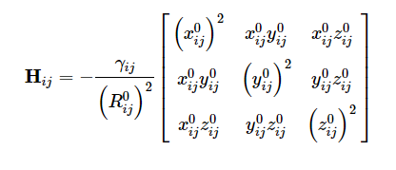
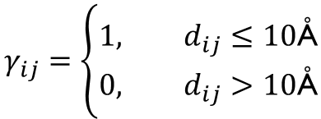
ANM Hessian
$$γ_{ij}=\left\{\begin{aligned}1, d_{ij}≤10\text{Å} \\ &0, d_{ij}>10\text{Å}\end{aligned}\right.$$

Slide 8
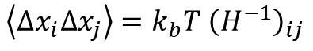
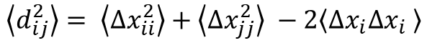
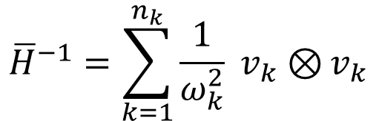
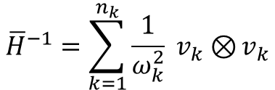
Formulation
Pairwise Distance
Fluctuations
$$\left\langle d_{ij}^{2}\right\rangle = \left\langle ∆x_{ii}^{2}\right\rangle +\left\langle ∆x_{jj}^{2}\right\rangle −2\left\langle ∆x_{i}∆x_{i} \right\rangle$$
# Of Modes
$${\overline{H}}^{−1}=\sum_{k=1}^{n_{k}}{\frac{1}{ω_{k}^{2}} v_{k}⊗}v_{k}$$
Covariance
$$\left\langle ∆x_{i}∆x_{j}\right\rangle =k_{b}T {\left(H^{−1}\right)}_{ij}$$
Eigenvectors/Normal Modes
Pseudo Inverse
$${\overline{H}}^{−1}=\sum_{k=1}^{n_{k}}{\frac{1}{ω_{k}^{2}} v_{k}⊗}v_{k}$$
Lowest Frequencies

Slide 9
Overview Of NMA
Input
PDB ID
Cutoff Distance
Select C-alpha Atoms
Construct Hessian
Solve Eigensystem
Construct Inverse
Calculate Distance Fluctuations
# Of Modes

Slide 10
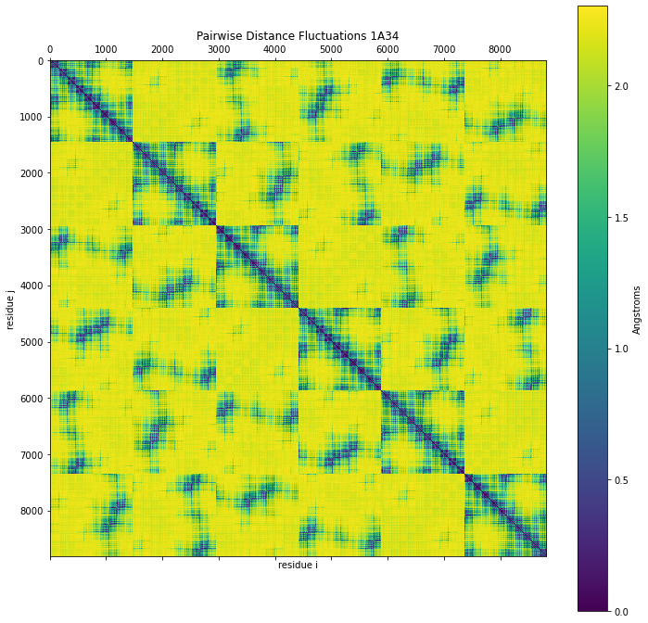
Distance Fluctuation Matrix

Slide 11
Mode Visualization

Slide 12
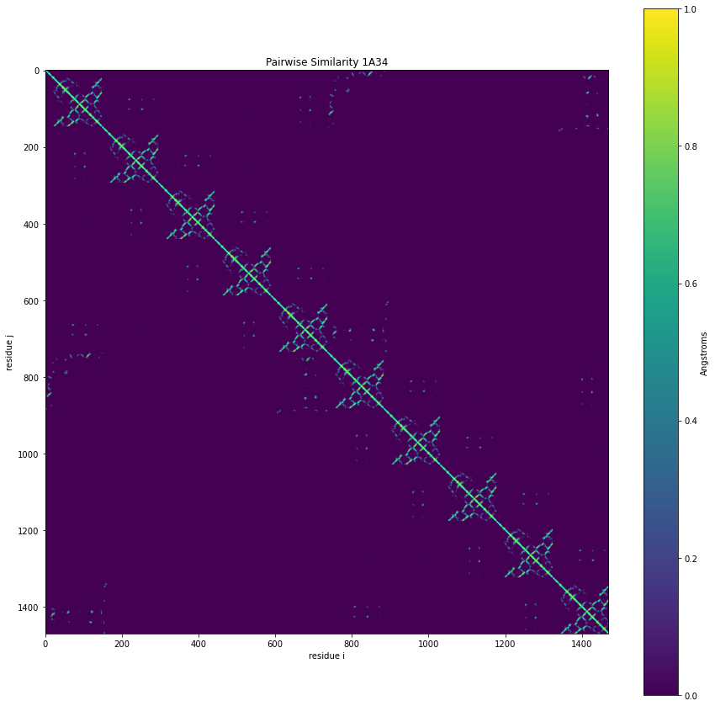
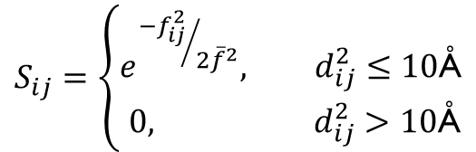
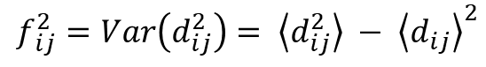
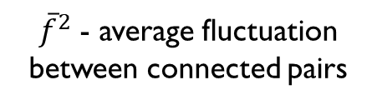
Domain Decomposition: Clustering Problem
Dissimilarity Matrix
$$f_{ ij}^{2}=Var\left(d_{ij}^{2}\right)= \left\langle d_{ij}^{2}\right\rangle − {\left\langle d_{ij}\right\rangle }^{2}$$
Similarity Matrix
$$S_{ij}=\left\{\begin{aligned}e^{{−f_{ij}^{2}}/{2{\overline{f}}^{2}}}, d_{ij}^{2}≤10\text{Å} \\ & 0, d_{ij}^{2}>10\text{Å}\end{aligned}\right.$$
${\overline{f}}^{2}$- average fluctuation between connected pairs

Slide 13
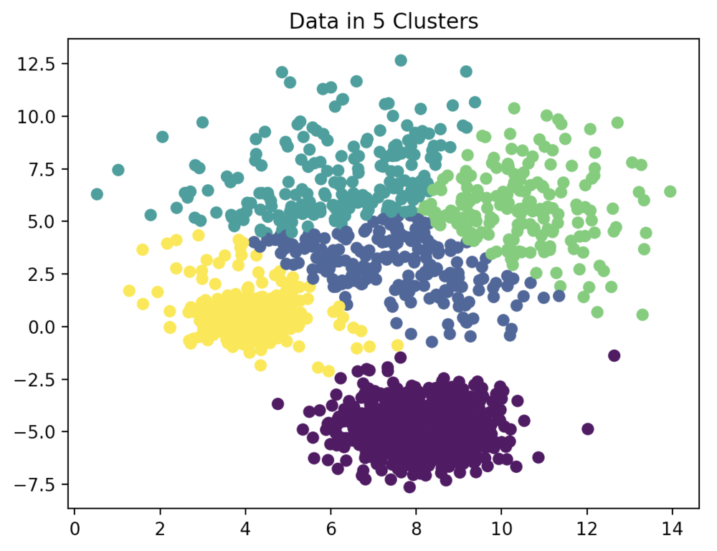
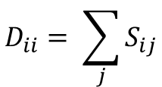
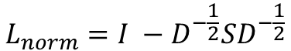
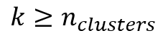
Spectral Clustering
Transform To Laplacian
Matrix
Calculate k Eigenvectors
Cluster Eigenvectors
$$L_{norm}=I −D^{−\frac{1}{2}}SD^{−\frac{1}{2}}$$
$$k≥n_{clusters}$$
K-Means
$$D_{ii}= \sum_{j}{S_{ij}}$$

Slide 14
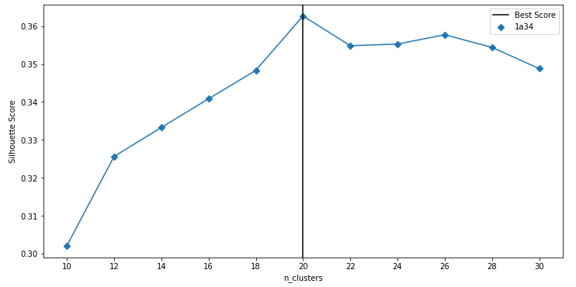
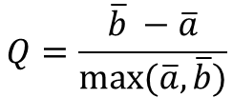
Spectral Clustering Quality
Silhouette Score
$$Q=\frac{\overline{b} −\overline{a}}{max⁡(\overline{a},\overline{b})}$$
b: Distance Between Clusters
a: Distance Between Points in Clusters

Slide 15
Results: 1a34

Slide 16
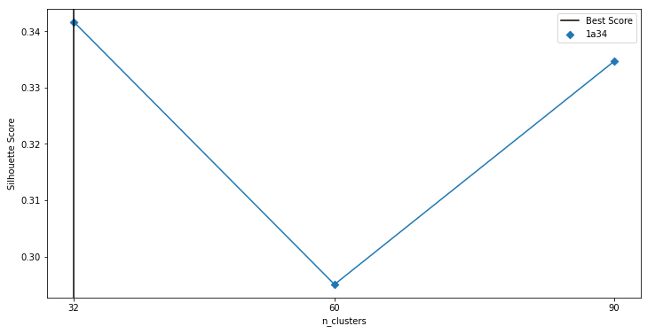
Results: 1Cwp

Slide 17
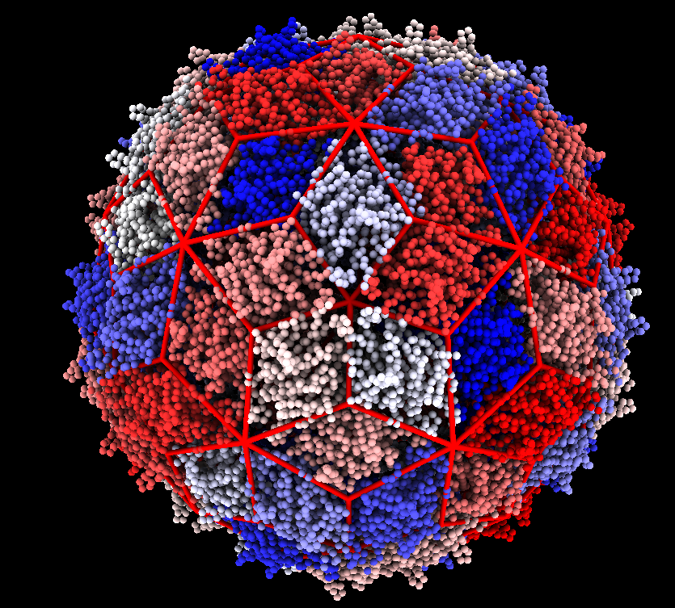
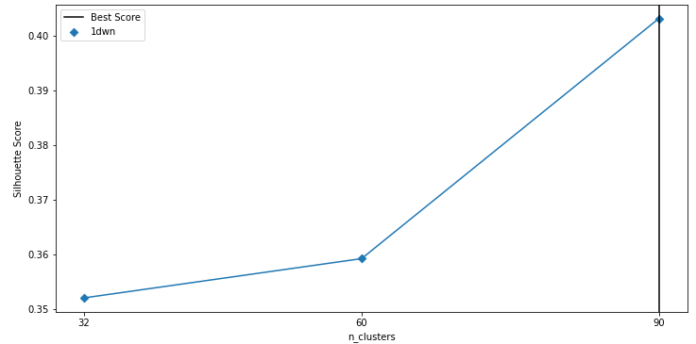
Results: 1dwn

Slide 18
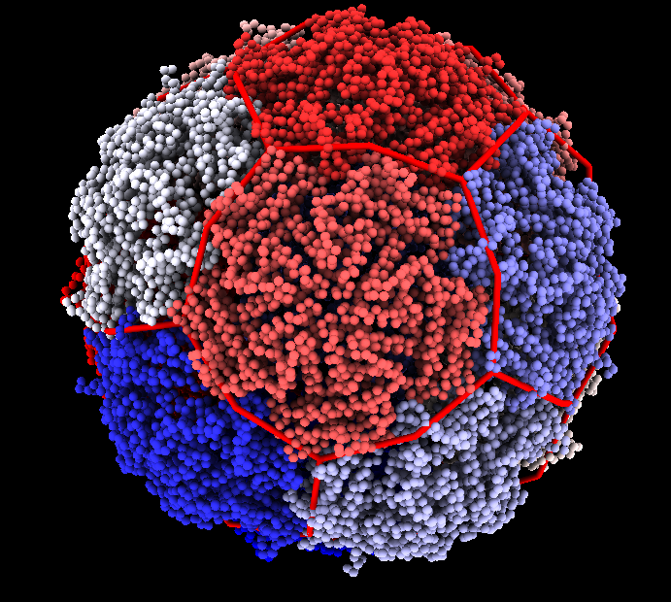
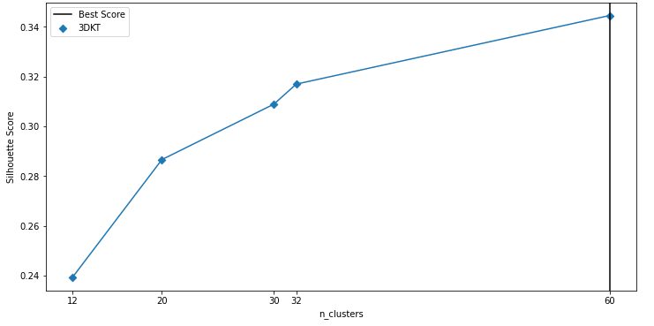
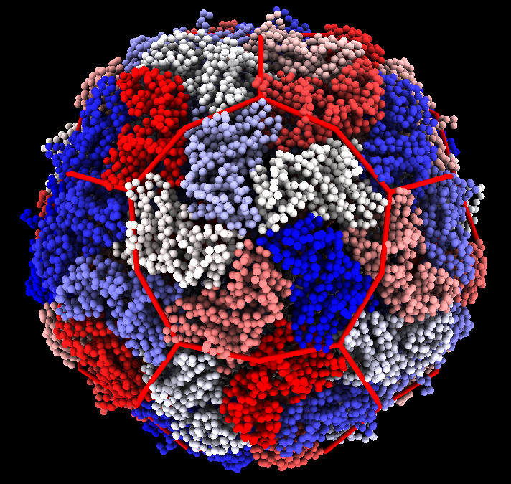
Results: 3dkt

Slide 19
END

Slide 20
Drawbacks

